Slide 1
Toxic Chemicals and Waste
Ayesha Mahmood, Marleen Perez

Slide 2
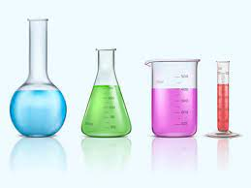
What are Chemicals?
Every material made up of matter is referred to as a chemical; this involves solids, liquids, and gases.

Slide 3
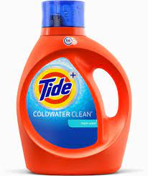
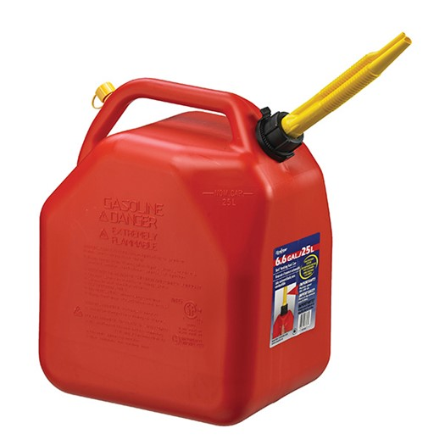
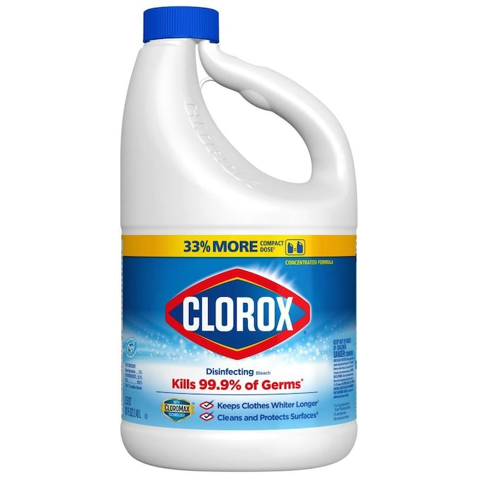
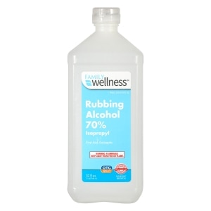
What are some common examples?
These include laundry detergent. Furniture polish, gasoline, bleach, rubbing alcohol)!
Do you have any of these chemicals at home?

Slide 4
Do you think certain chemicals can affect our health?

Slide 5
If you said yes….
You are correct!

Slide 6
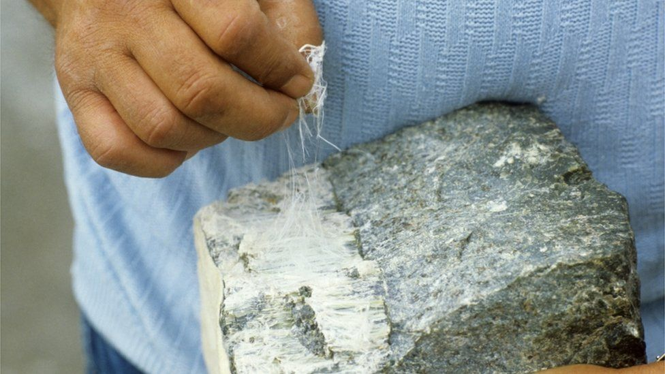
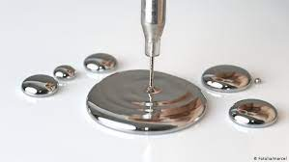
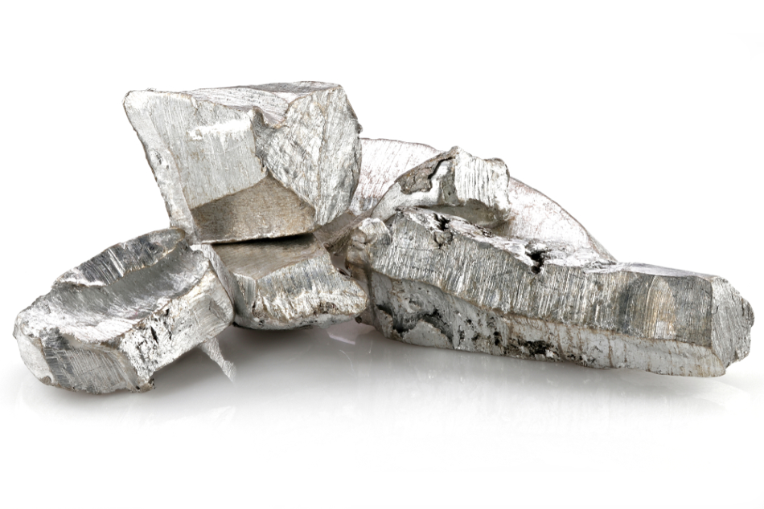
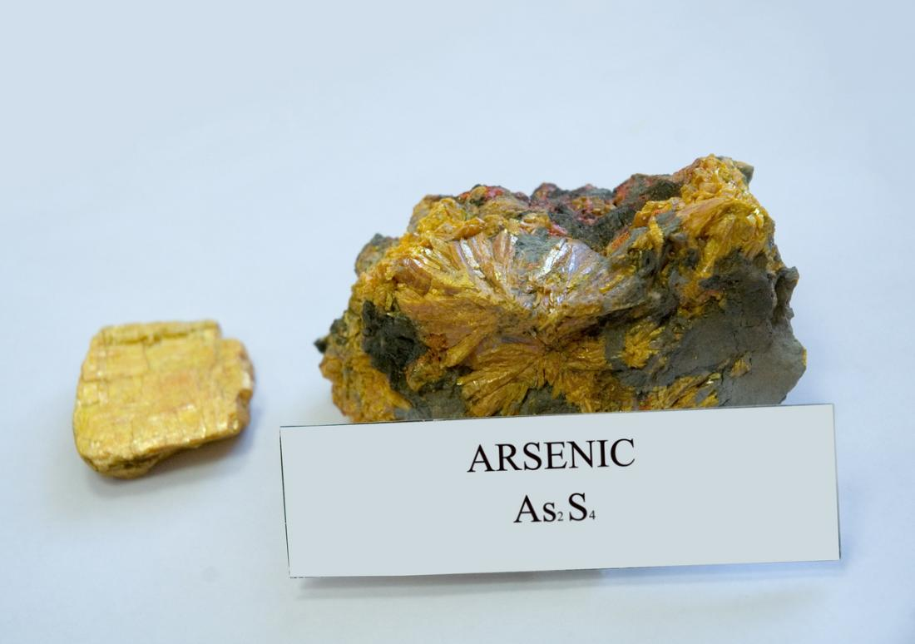
Examples of Toxic Chemicals
Mercury
Asbestos
Arsenic
Cadmium
-
Notes:
-Mercury is an element that can be contained in the air, water, and soil. Mercury can damage the nervous, digestive, and immune systems. As well as the lungs, kidneys, skin, and eyes.
-Asbestos (as best is) is a mineral that occurs naturally and is made up of delicate, flexible fibers (that are resistant to heat, electricity, and corrosion). This is beneficial because it can be used to strengthen materials. For example, Cloth, paper, cement, plastic, and others. However, asbestos is extremely hazardous. It can cause a rare cancer called mesothelioma,(mesla feli oma) as well as lung cancers and more.
-Arsenic is found in high concentrations in the groundwater of a variety of countries. Long-term exposure to arsenic from drinking water and food can have many negative effects. Such as cancer, skin lesions, cardiovascular disease, and diabetes. If young children are exposed to this they may have negative impacts on their development. Many have died due to this.
-Cadmium and its components are highly harmful, and they have been linked to cancer in the cardiovascular, renal, gastrointestinal, neurological, reproductive, and respiratory systems.

Slide 7
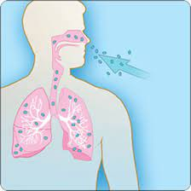
Who does it affect?
Chemicals can have a positive effect on the world
Dopamine: (A neurotransmitter)It aids in movement, concentration, learning, and the pleasure and reward function of the brain.
These toxic chemicals affect humans and the health of our environment
Cancers, Kidney Failures, Genetic mutations, and more
-*Definition of Mutations* : when the pattern of DNA changes.
Notes:
and its modernization, but that doesn’t mean that they are beneficial for the earth’s environment.
(Behavioral anomalies, cancer, genetic mutations, anatomical malfunctions such as kidney failure, physical deformities, and birth defects are just a few examples)
This is because these chemicals get released into the air, water, and soil. **For example, there are toxins in the air we are then breathing in toxic chemicals.* This also goes in hand with the water we drink and the food we eat. We can get extremely sick because of this and even get cancer!

Slide 8
How are chemicals released into the air?

Slide 9
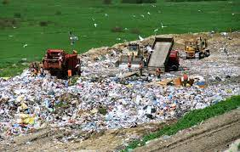
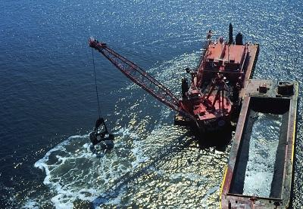
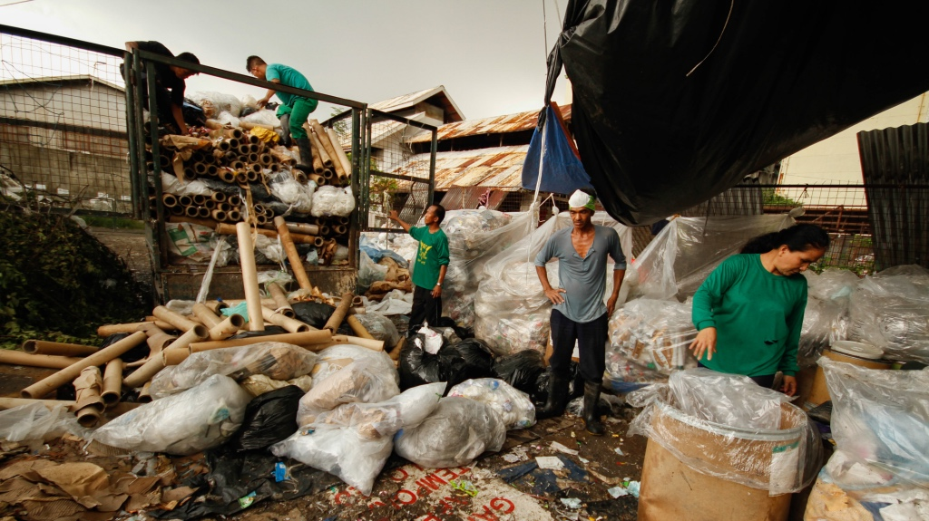
How do chemicals get released?
Facilities release chemical waste
Industrial Buildings: Where products are made (fabrics, plants).
Notes:
Facilities are industrial buildings or office buildings.
These facilities want to get rid of chemical waste on their land, so they do that by releasing it into the air or dumping it into the water.
This may be beneficial for them since they are getting rid of it from their “land,” it’s still horrible for the planet and human health!

Slide 10
How does this affect our communities/ NJ?

Slide 11
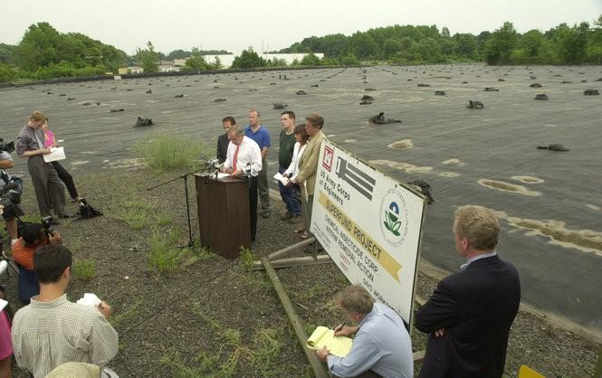
South Jersey Clothing Company
The South Jersey Clothing Company sold military apparel, in NJ.
In this company's manufacturing process there was discharging water that was tainted with trichloroethylene (TCE for short).
This company was responsible for a fire in the 1970s.
People should definitely evacuate out of their homes to prevent sickness.
Notes:
TCE is a toxic chemical associated with dry cleaning.
Around 300 gallons of TCE were released into the field.
Since TCE was exposed to the environment, residents of New Jersey health was affected.

Slide 12
When did this start becoming a problem?

Slide 13
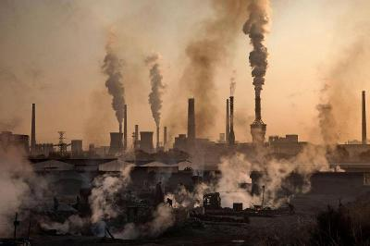
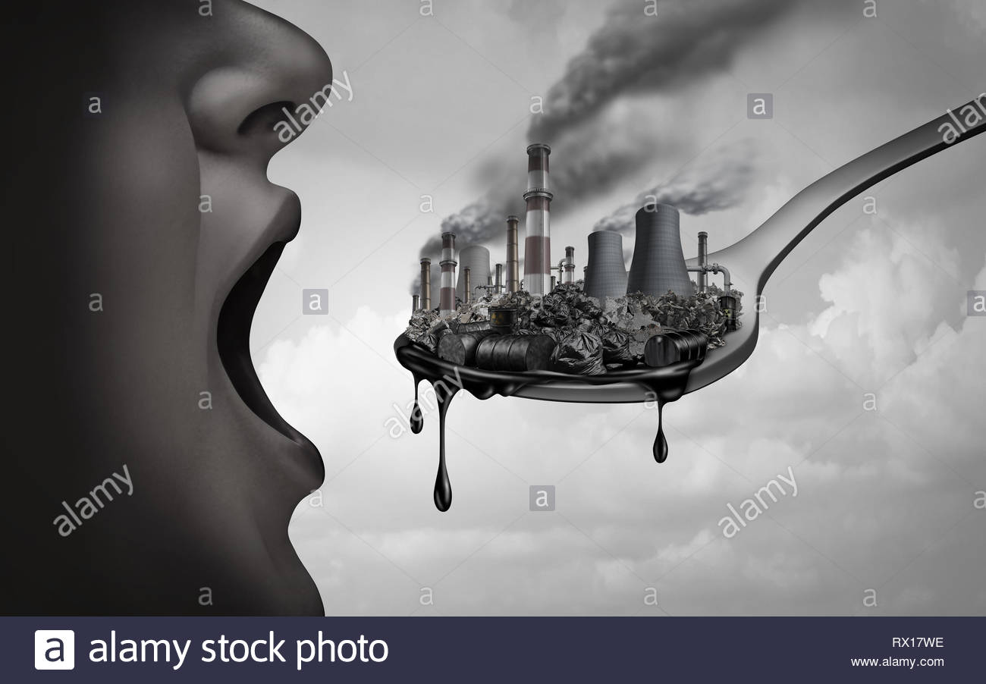
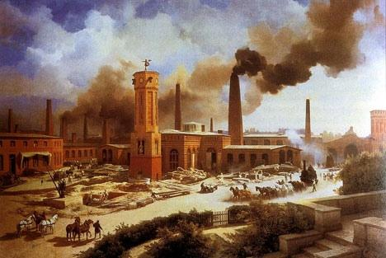
A Little History on Toxic Chemicals
The Industrial Revolution
A period from 1760 to 1840
More pollution and release of toxic chemicals
Notes:
These chemical issues were taken seriously in the 1970s and continue to be a problem. The birth of these chemical issues started during the Industrial Revolution.
more manufacturing machines were invented, people were moving from farm life to a more industrial life.
-People were sick because they were breathing in toxins like smoke, soot, and carbon monoxide.

Slide 14
Environmental Regulators
EPA: Environmental Protection Agency
TSCA: The Toxic Substances Control Act

Slide 15
What Can You Do?

Slide 16
Solution
Recycle (especially stuff like lightbulbs)
Buy NPE-free green detergents (Tru Earth Eco-Strips Laundry Detergent Strips)
Use paints and polish that have ingredients that aren’t bad for the planet. Some environmentally friendly paints are Clare Paint and BioShield.

Slide 17
Important Labels

Slide 18
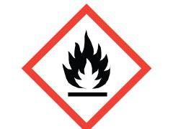
Name: Flame
Meaning: Flammable materials or substances that can self ignite when exposed to water or air, which emit flammable gas.

Slide 19
Name: Exclamation Mark
Meaning: An irritant to the skin, eyes, or respiratory system

Slide 20
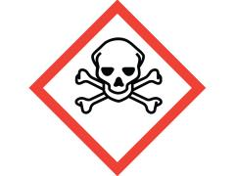
Name: Skull and Crossbones
Meaning: Poisons and heavily concentrated acids, might have an immediate and severe toxic effect.

Slide 21
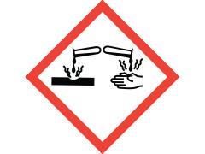
Name: Corrosion
Meaning: Materials causing skin corrosion/burns or eye damage on contact, or that are corrosive to metals.
-Corrosion are materials that can destroy and damage exposed body tissues chemically.

Slide 22
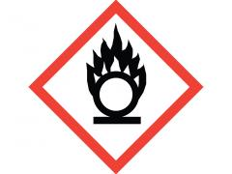
Name: Flame Over Circle
Meaning: Identifies oxidizers. Oxidizers are chemicals that make fires burn hotter and longer.

Slide 23
Name: Environmental Hazard
Meaning: Toxic to sea life.

Slide 24
Let’s Play a Game!

Slide 25
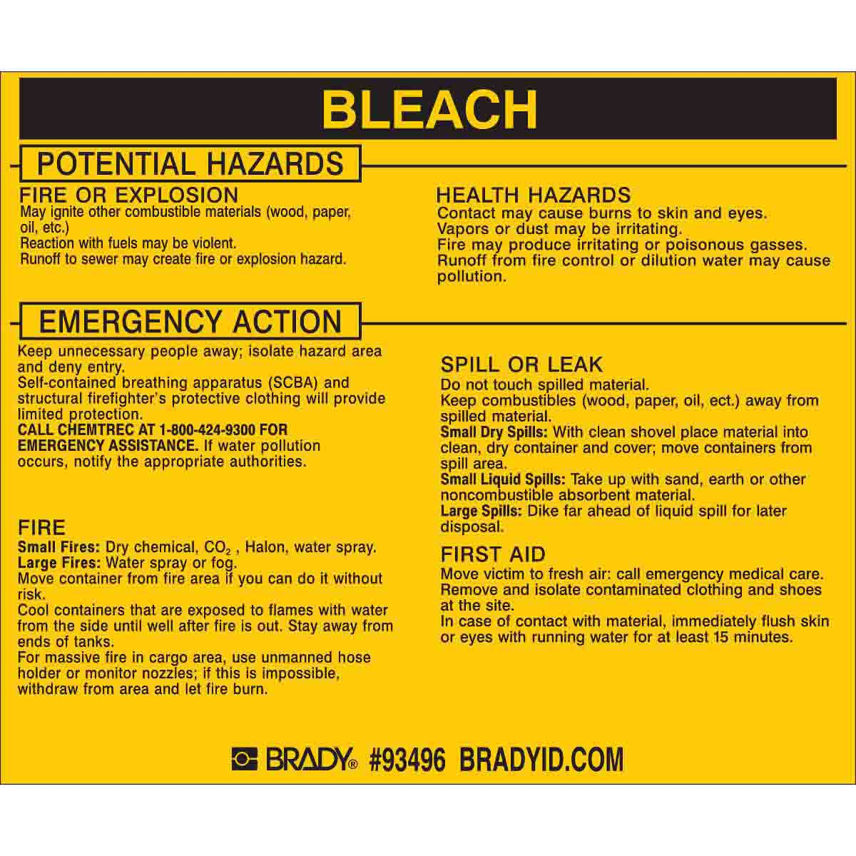
Which words indicate that this product is toxic?
“Fire or Explosion”
“Health Hazards”
“Emergency Action”
“All of the Above”
Correct Answer:
D. All of the Above

Slide 26
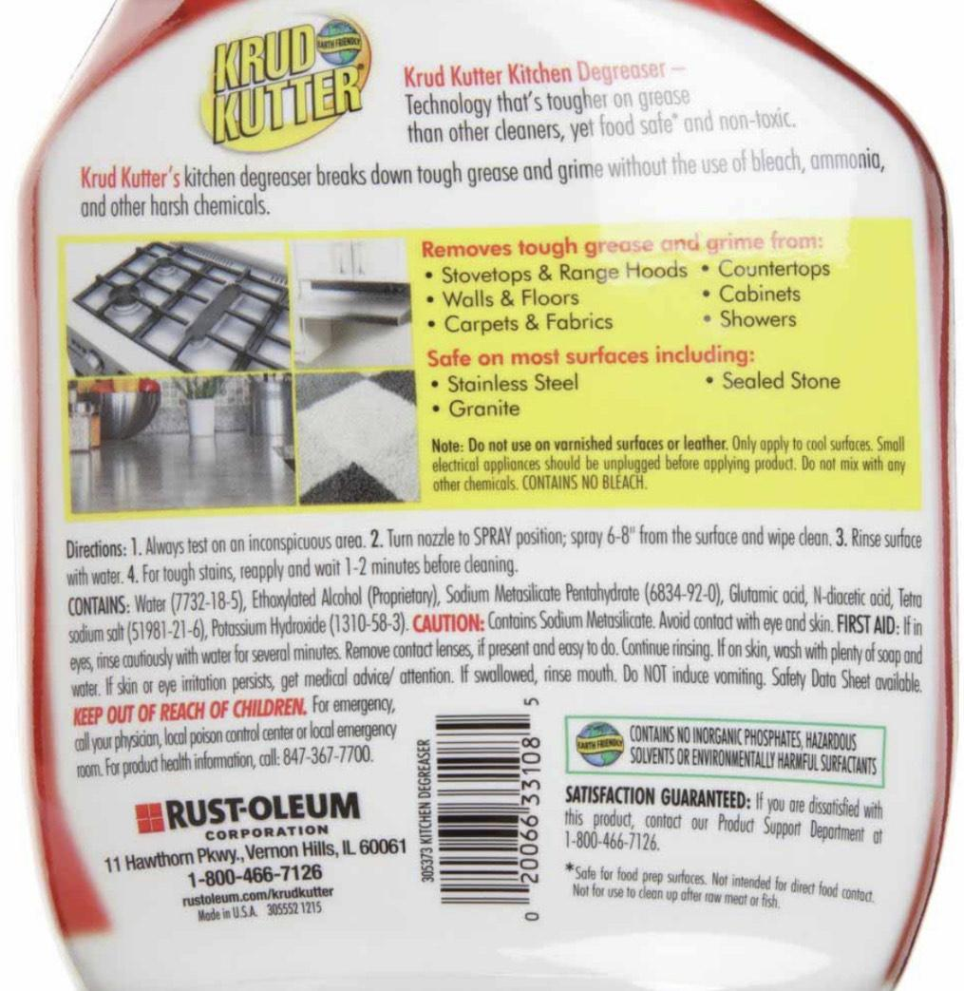
Which words indicate that this product is NOT toxic?
“Keep out of reach of children”
“Walls & Floors”
“Contains no inorganic phosphates, hazardous solvents or environmentally harmful surfactants.”
“First Aid”
Correct Answer:
C. “Contains no inorganic phosphates, hazardous solvents or environmentally harmful surfactants.”

Slide 27
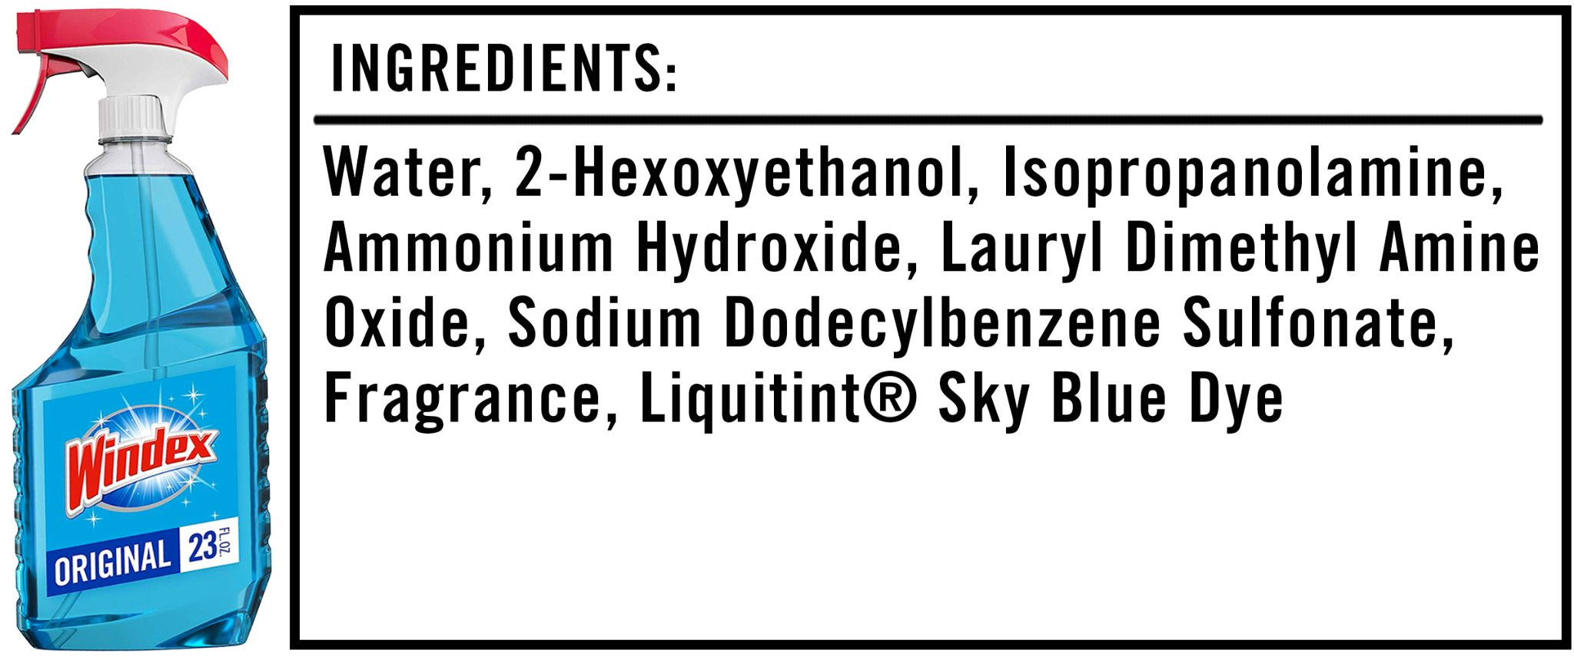
Which of these ingredients
are toxic?
Ammonium Hydroxide
Water
Fragrance
None
Correct Answer:
Ammonium Hydroxide

Slide 28
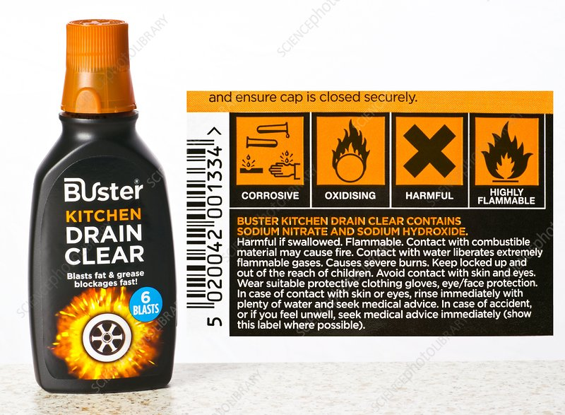
What do each of those symbols mean?
Options:
Oxidising
Highly flammable
Corrosive
Harmful
1
2
3
4

Slide 29
Thank You!
If you have any questions email thegreencauseinitiative@gmail.com

