Slide 1
Deforestation
and Animals
By: Jasmine Ali

Slide 2
Part 1
Deforestation

Slide 3
Why are trees important?
Notes:
Trees are vital. As the biggest plants on the planet, they give us oxygen, store carbon, stabilise the soil and give life to the world’s wildlife. They also provide us with the materials for tools and shelter. Not only are trees essential for life, but as the longest living species on earth, they give us a link between the past, present and future.

Slide 4
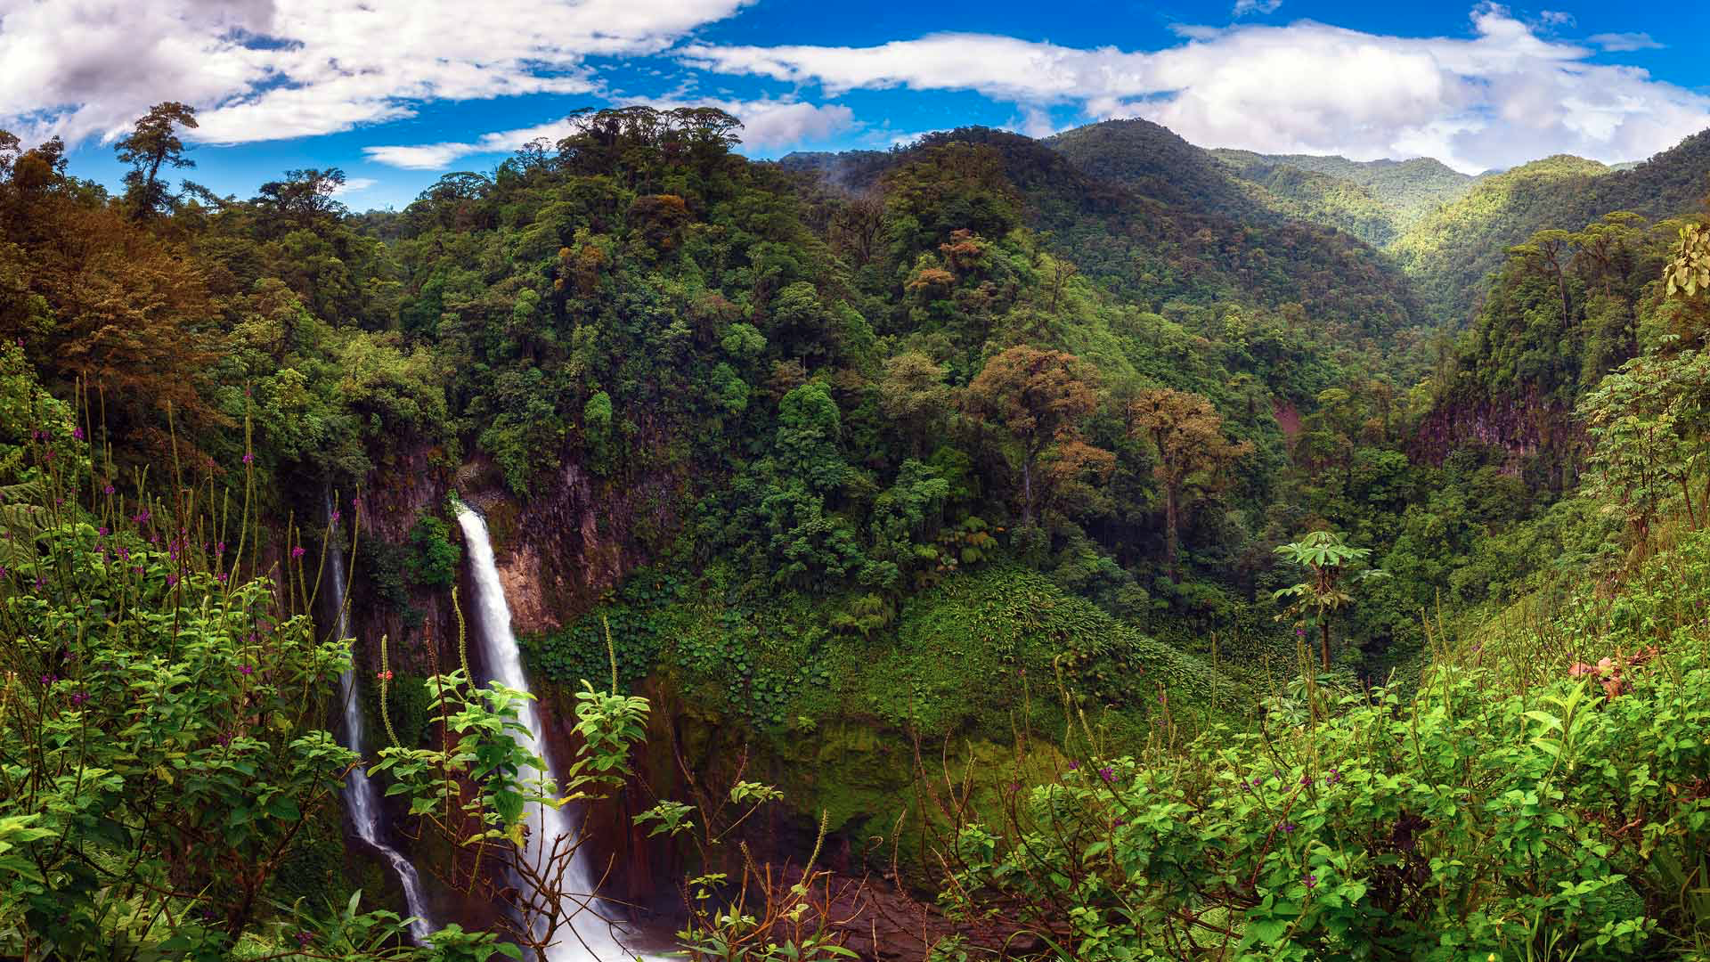
The Benefits of Rainforests
Regulate Earth’s temperature
Provide Oxygen
Is home to 30 millions of species
Help make medicines
Filter water
Prevent soil erosion
And much more!
Notes:
Rainforests help regulate the Earth’s temperature and weather patterns. 20% of our oxygen is produced in the Amazon.. It took 60 to 100 million years for Rainforests to evolve and it is the home of over 30 million species of plants and animals. Trees help absorb the harmful carbon dioxide that we humans release in the atmosphere and they provide the oxygen that we need to breathe. More than 25% of our medicines today come from rainforest plants. They soak up a lot of rainfall. The rainwater is filtered through the forest floors and supplies water to rivers and irrigation systems. They also help prevent erosion. .They are home to indigenous people. If we don’t stop deforestation, more than half of our plant and animal species will be extinct. It is the oldest ecosystem on Earth and they are impossible to replace.

Slide 5
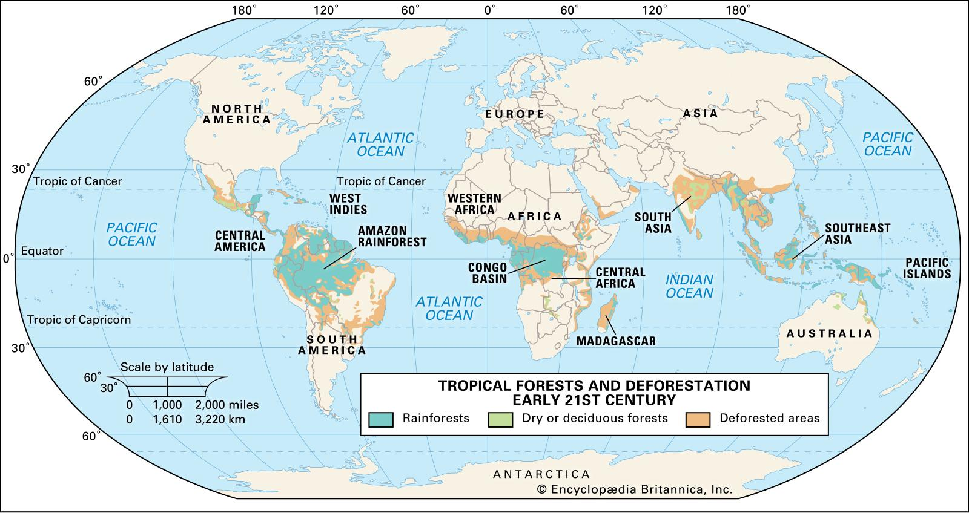

Slide 6
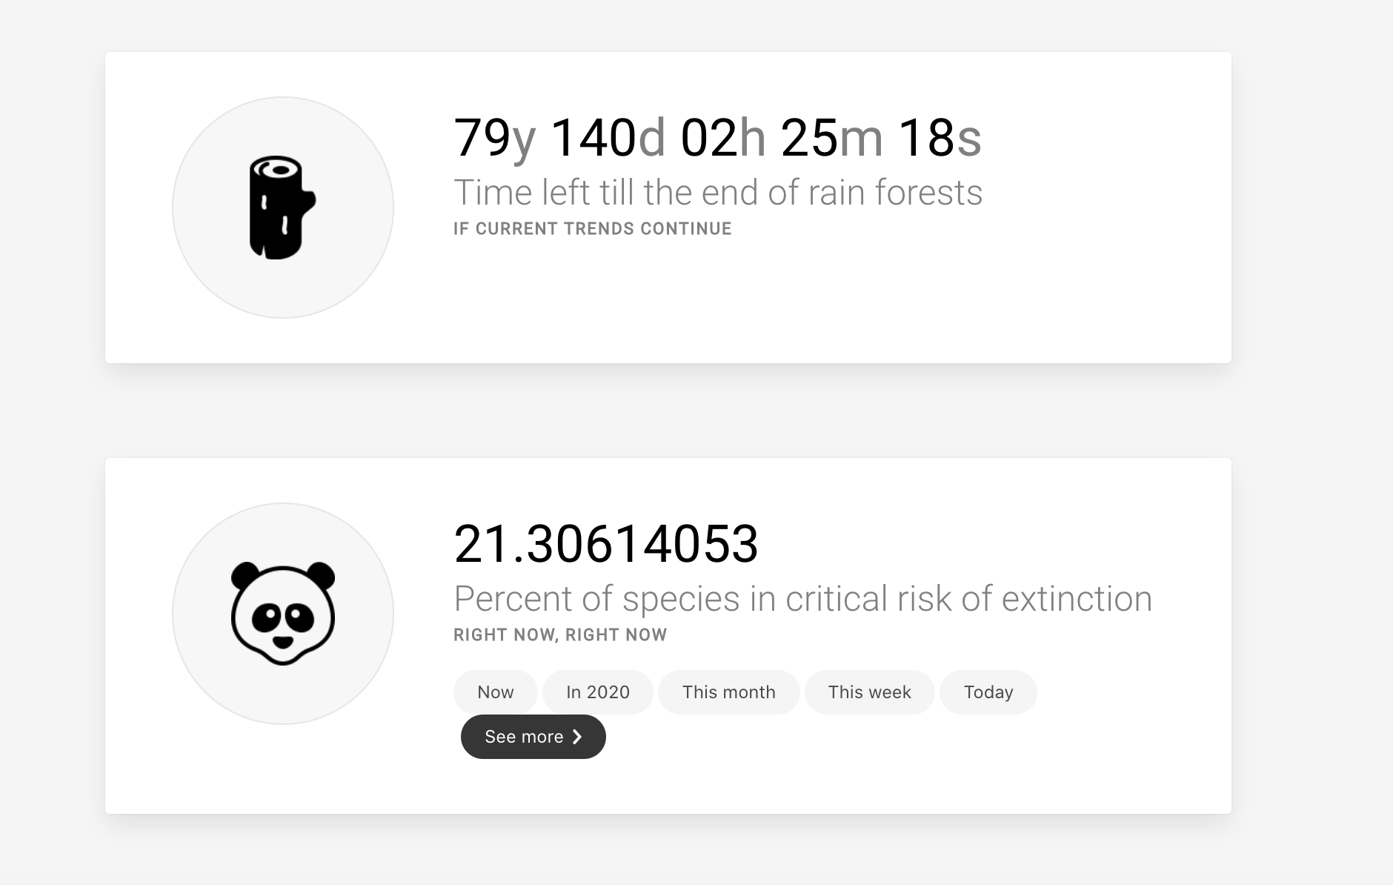
Danger
Every minute, forest the size of 20 football fields is cut down.

Slide 7
The Causes
1
3
2
4
Agriculture
Illegal Logging
80% of deforestation and 91% of Amazon
80%-90% of deforestation is illegal
Cattle Ranching
Mining
80% of Amazon deforestation
7%-10% of deforestation

Slide 8
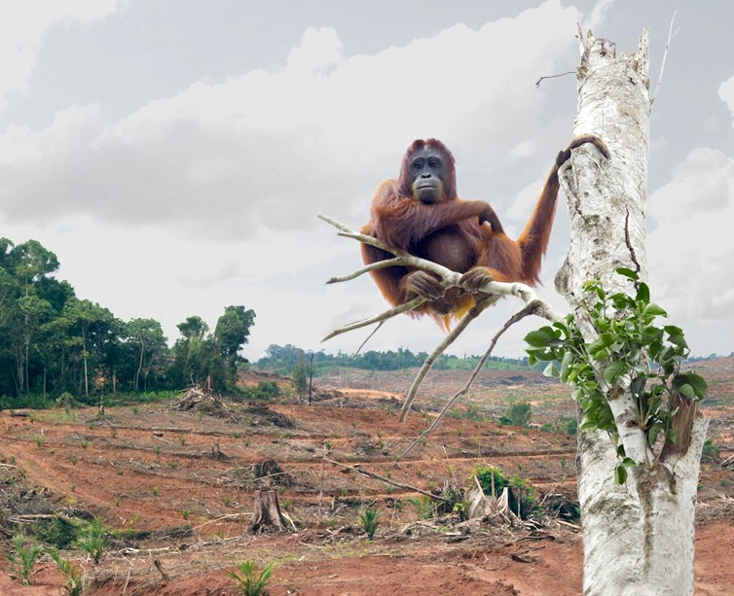
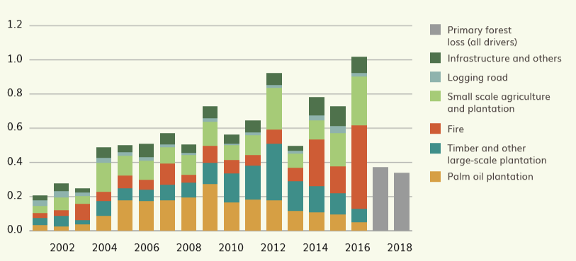
Notes:
Agriculture-
Rising demand for soy, palm oil (Palm oil is a key ingredient found in just about every product sold on supermarket shelves worldwide), cocoa and coffee is translating into expanding plantations for these crops worldwide. Many of us unknowingly contribute to forest conversion in our consumption of everyday products.. This human 'footprint' on the Earth shows how our behavior in one part of the world can have negative impact on tropical forests and the people living in other part of world. Agricultural activities are the principal driver of deforestation and degradation worldwide, but it varies regionally. For example, subsistence agriculture and fuelwood consumption remains an important direct driver of deforestation in Africa. Cattle ranching and large-scale agriculture are major drivers of deforestation in Latin America, whereas palm oil development, intensive agriculture, and pulp and paper plantations are principal drivers in Indonesia.

Slide 9
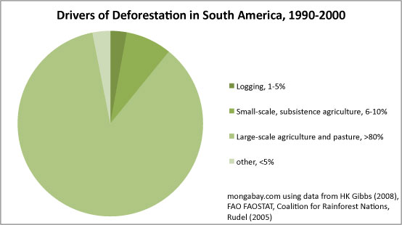
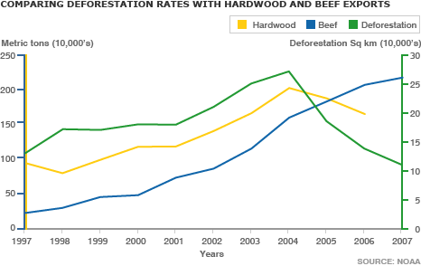

Slide 10
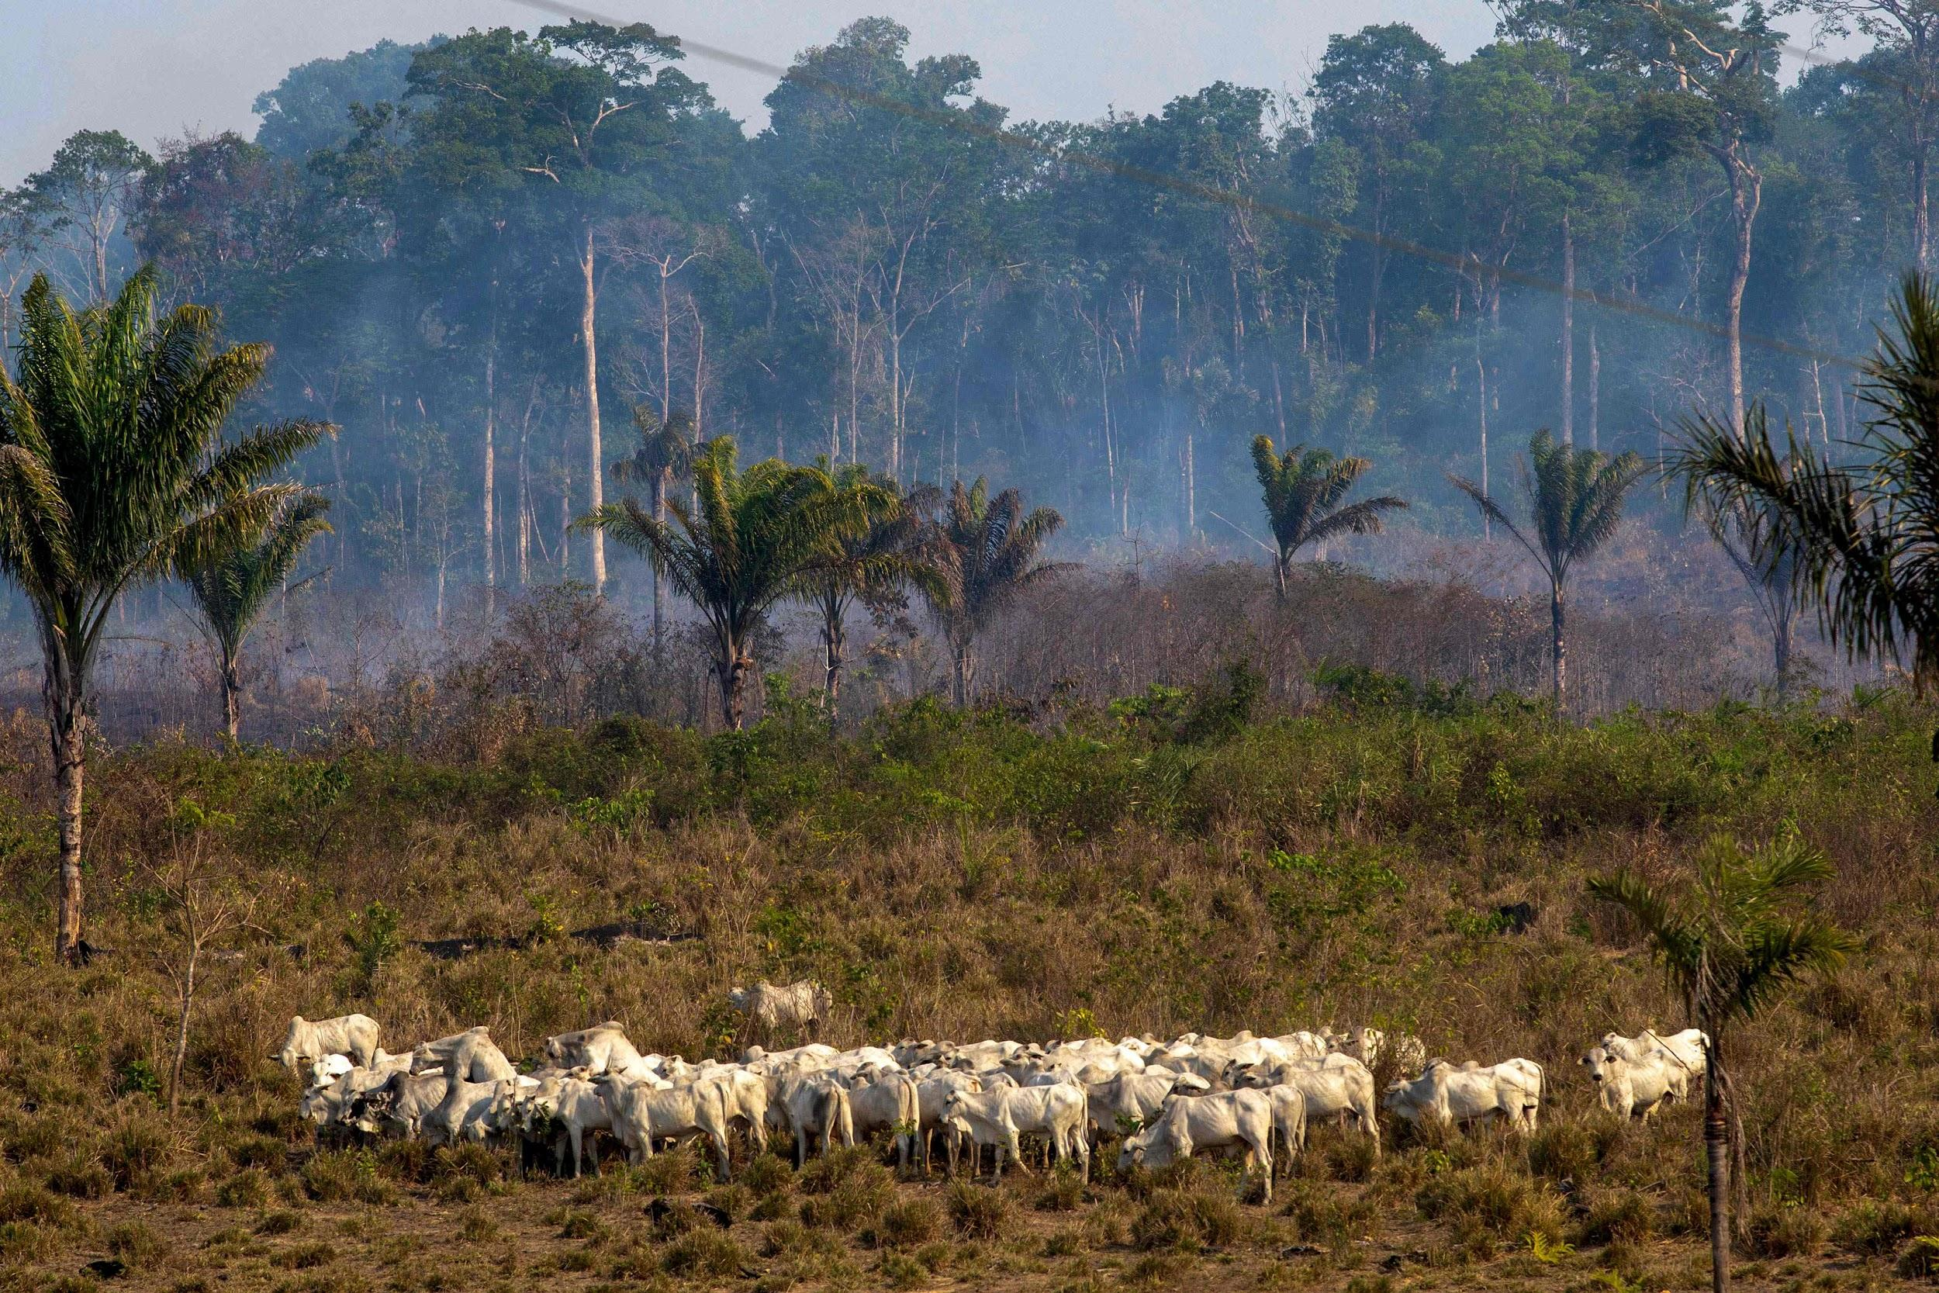
Notes:
Cattle Ranching-
Cattle ranching — and the soy farming needed to feed the cattle — is the biggest cause of deforestation in virtually every Amazon country. Around 90% of soy is used to feed animals to produce meat and dairy products. Worldwide, deforestation due to cattle ranching releases 340 million tons of carbon into the atmosphere each year, or 3.4 percent of global greenhouse gas emissions. Most of this comes from the Amazon region. Animal agriculture, livestock, and animal feed is a significant driver of deforestation, and is also responsible for approximately 60% of direct global greenhouse gas emissions. Cattle ranching is the largest driver of deforestation in every Amazon country, accounting for 80% of current deforestation rates. Amazon Brazil is home to approximately 200 million head of cattle, and is the largest exporter in the world, supplying about one quarter of the global market. Low input cost and easy

Slide 11
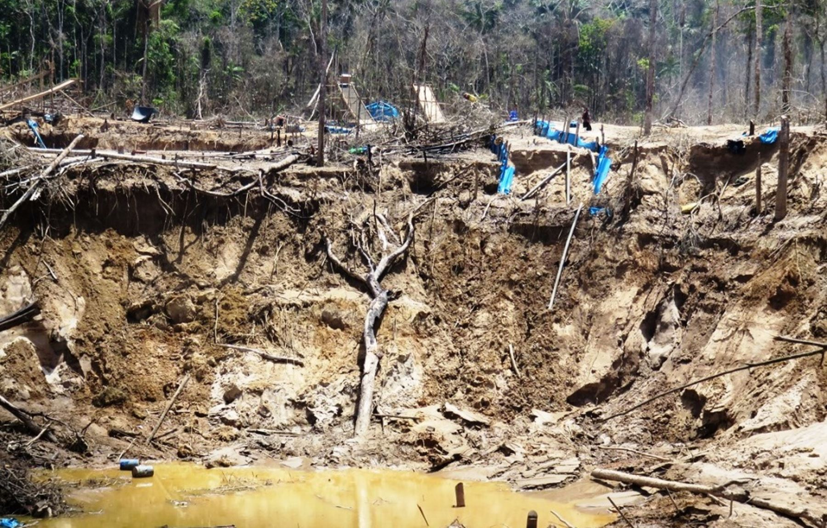
Notes:
Illegal Logging-
Illegal logging is having a devastating impact on the world’s forests. Its effects include deforestation, the loss of biodiversity and fuelling climate change. This creates social conflict with Indigenous and local populations and leads to violence, crime and human rights abuses.It is estimated that some 1.6 billion people worldwide depend on forests for their livelihood and 60 million Indigenous peoples depend on forests for their subsistence. In Indonesia it is estimated that up to 90% of logging is illegal. In the Brazilian Amazon it is estimated that 60-80% of logging is illegal. Even when loggers come in to cut down certain kinds of trees all of the other trees in the area are frequently cut down as well. Other trees are cut down at the same time or once loggers have cut down the more profitable trees in the area. When exotic woods are found in Indigenous areas, these communities are especially vulnerable as powerful companies pressure governments to give them permits to log, and illegal loggers enter and cut down trees without bothering to obtain permits. Revenue from illegal logging activities has been used to fund civil wars, organised crime and money laundering. Weak governance and corruption in timber producing countries and the failure of governments in consumer countries like the US to ban the import of illegally logged timber, allows logging companies and timber traders worldwide to exploit ancient forests.
Mining-
The Amazon rainforest in South America has large quantities of copper, tin, nickel, manganese, iron ore and gold, making it attractive to mining companies all around the world. But as the governments of the eight countries that cross the Amazon eagerly try to profit on this wealth, concern is growing over the deforestation caused by, amongst other things, mining. The mining process involved forests to be burned down, striping away the earth and making regrowth much harder, and rivers and streams often become contaminated by mining waste such as mercury. This water pollution is detrimental to the people, animals, and indegenious communities that live downstream from the river. Other toxic compounds are used and generated in the mining process as well. Mining exposes previously buried metal sulfides to atmospheric oxygen causing their conversion to strong sulfuric acid and metal oxides, which run off into local waterways. Cyanide, a highly toxic compound, is also often used to separate gold from sediment and rock. While cyanide is supposed to be carefully monitored to prevent its escape into the surround environment, spills do occur—especially when there's no one around to enforce mining regulations

Slide 12
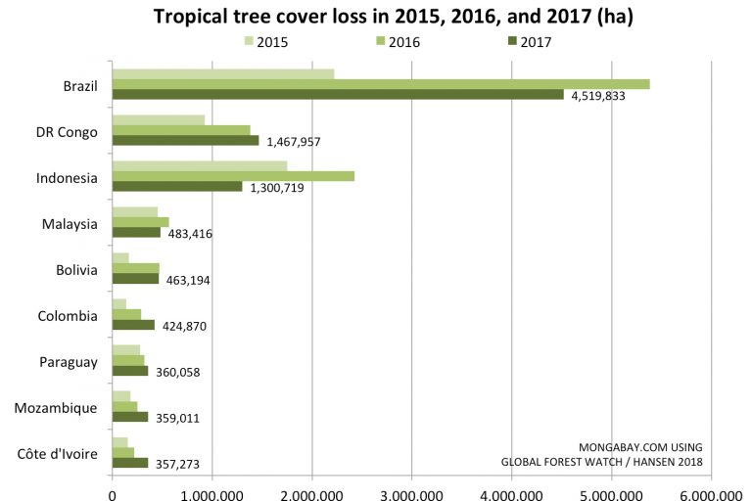
14% of Earth → 8-7%

Slide 13
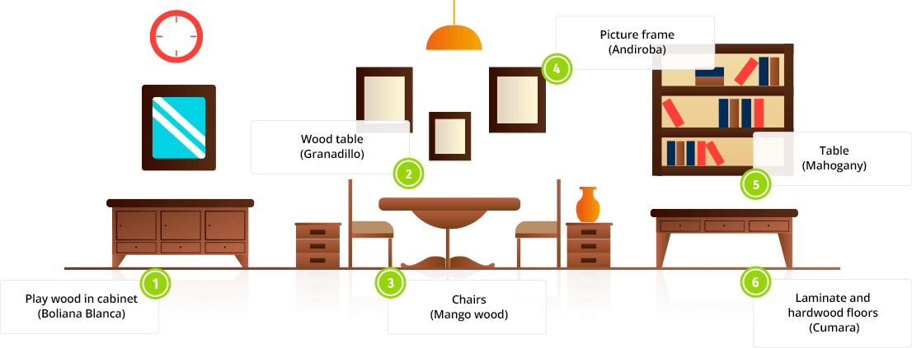
Hiding in Plain Sight

Slide 14
What Can You Do?
Plant a Tree
Go Paperless
Buy Recycled Products
Limit Beef and Dairy
Limit Palm Oil
Consume Less
https://www.insider.com/deforestation-photos-2019-4

Slide 15
Part 2
Animals

Slide 16
Animals Affected
Every species worldwide is impacted by climate change. Rising temperatures and sea levels, less rain and more droughts. By 2100, an estimated 50% of all the world’s species could go extinct because of climate change.

Slide 17
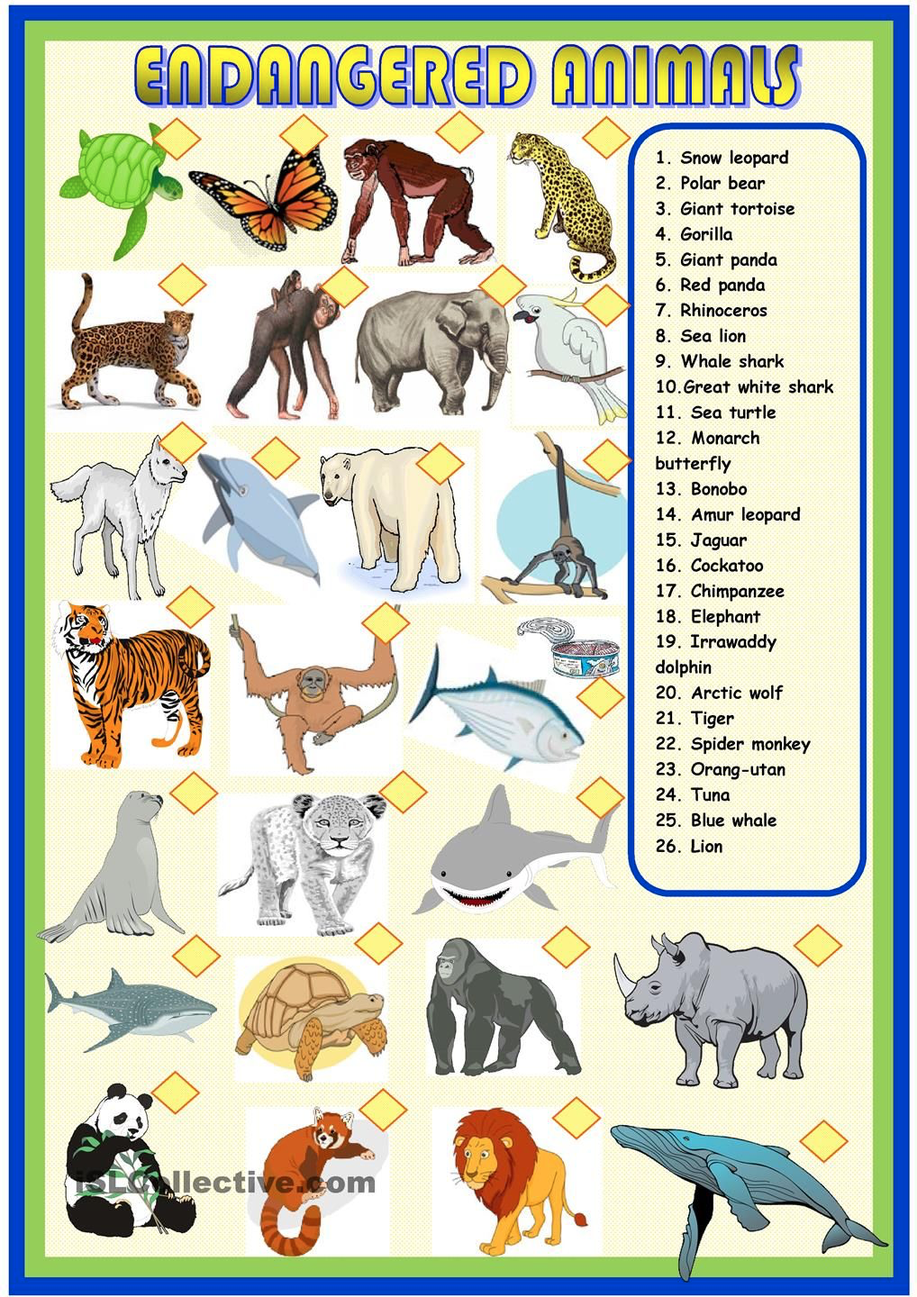
More Animals
Bumblebees Asian elephants
Giraffes Insects
bird species Great apes
and more

Slide 18
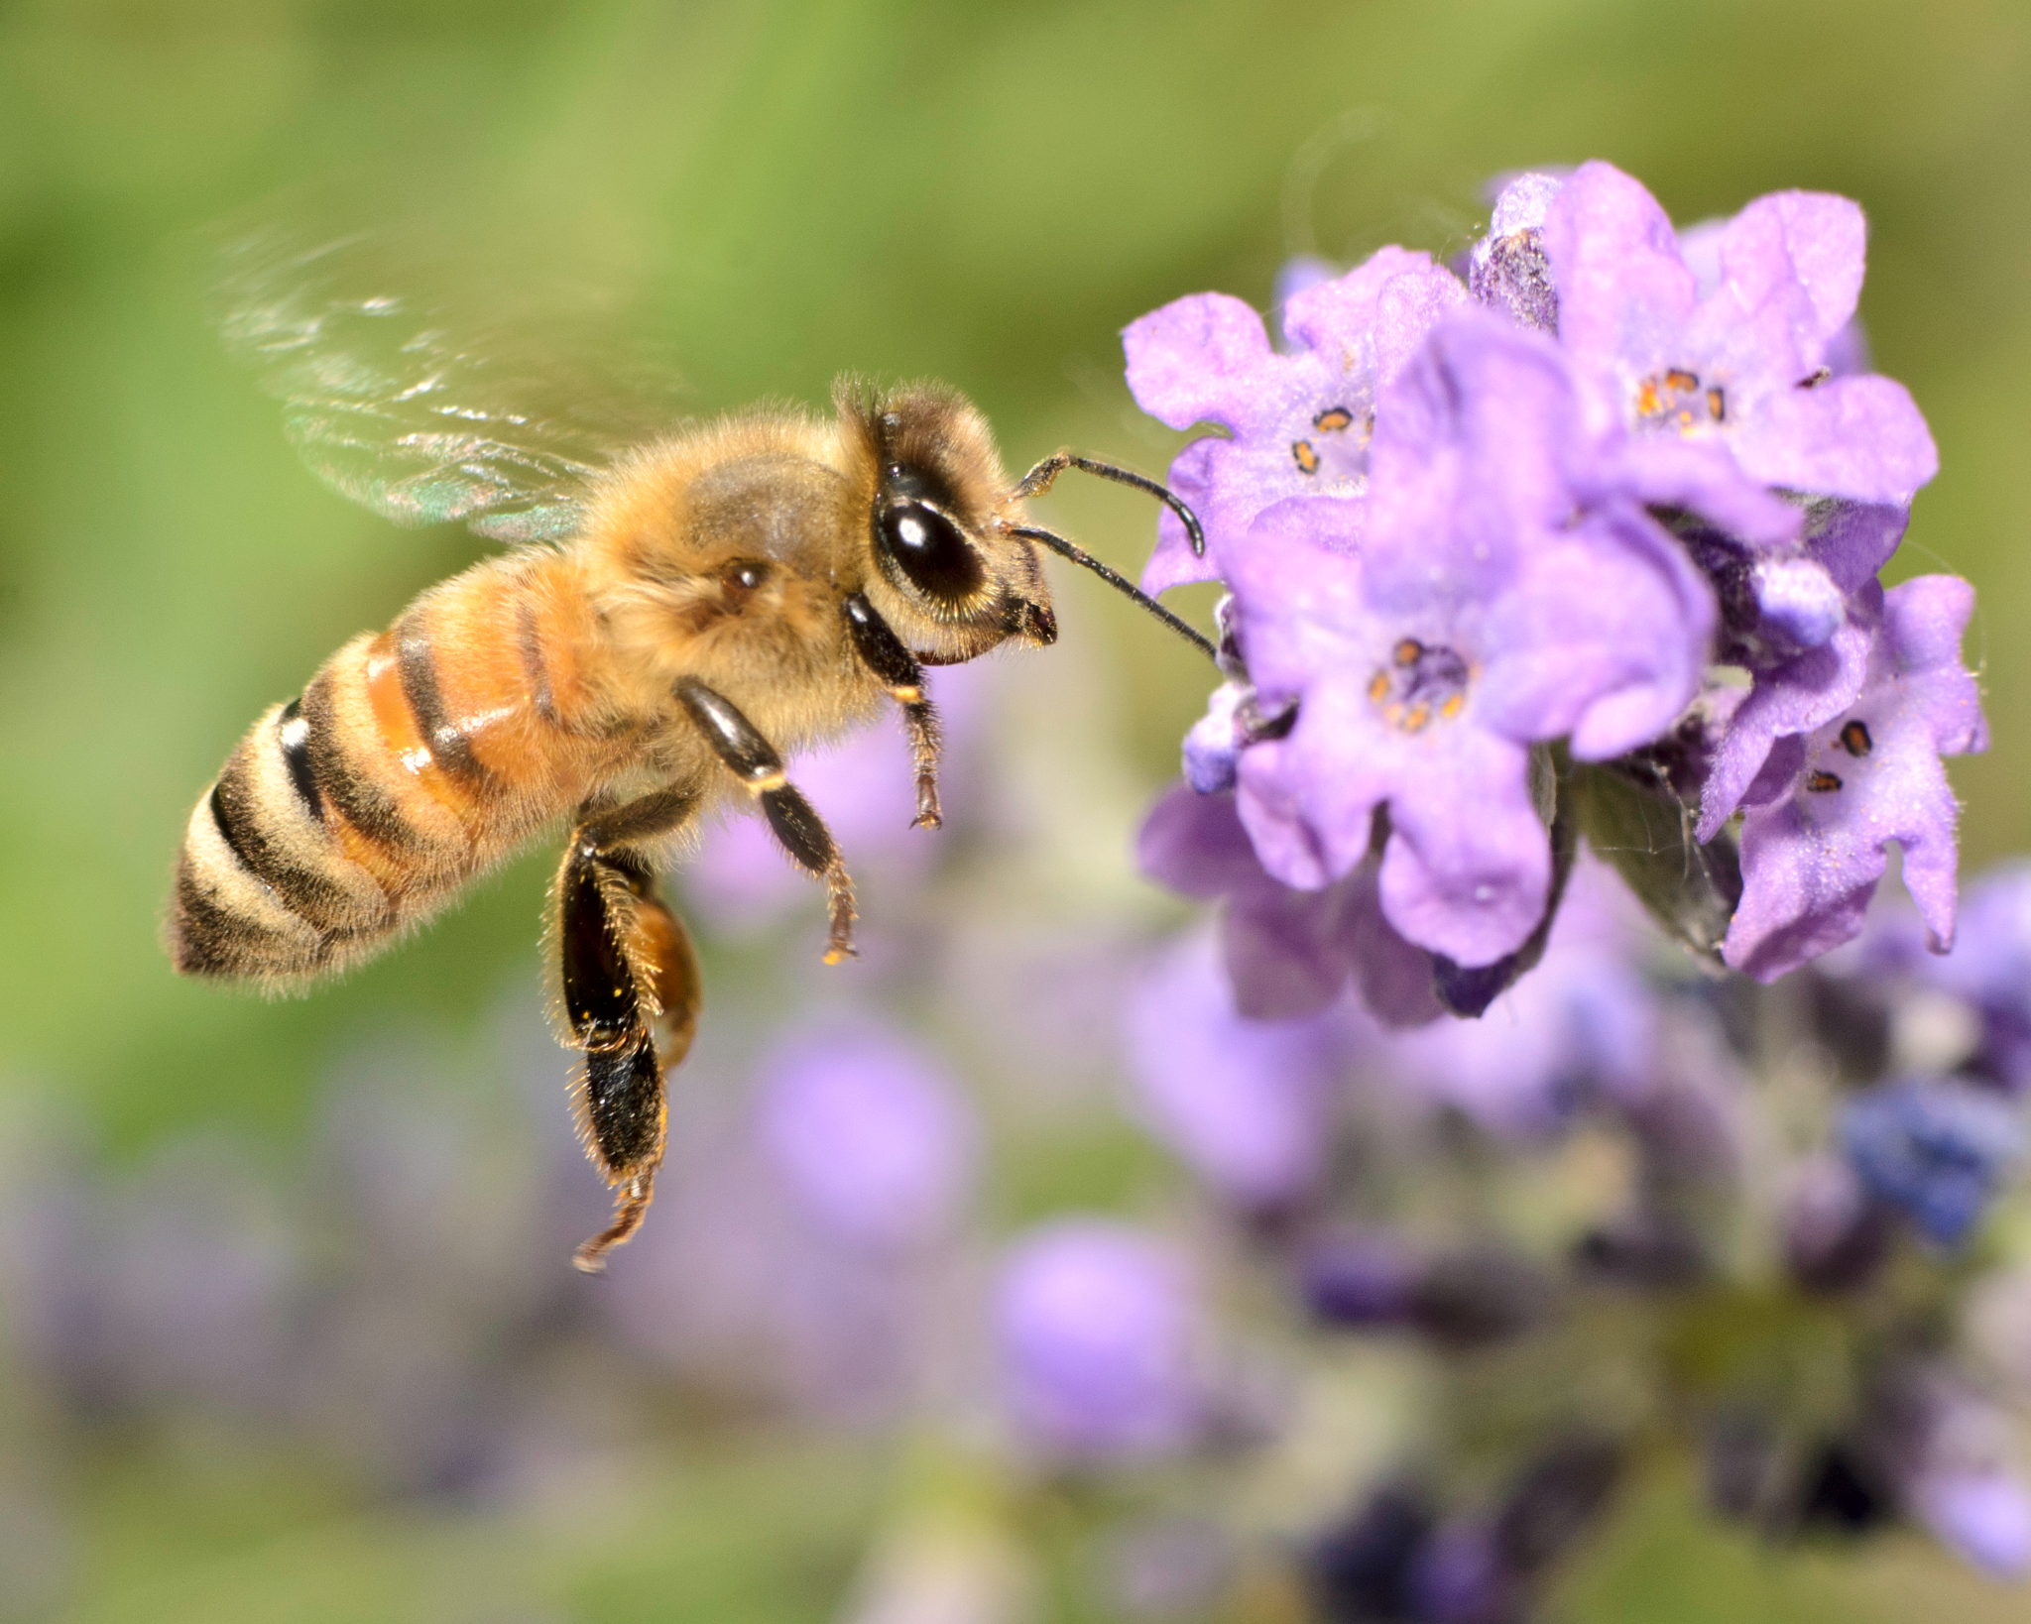
Example: honey bees
Notes:
Honey bees — wild and domestic — perform about 80 percent of all pollination worldwide. A single bee colony can pollinate 300 million flowers each day. Grains are primarily pollinated by the wind, but fruits, nuts and vegetables are pollinated by bees. Seventy out of the top 100 human food crops — which supply about 90 percent of the world’s nutrition — are pollinated by bees. Bees are dying from a variety of factors—pesticides, drought, habitat destruction, nutrition deficit, air pollution, global warming and more. Many of these causes are interrelated. Furthermore, wild bee habitat shrinks every year as industrial agribusiness converts grasslands and forest into monoculture farms, which are then contaminated with pesticides. To reverse the world bee decline, we need to fix our dysfunctional and destructive agricultural system. To help save the bees, you can plant a garden and ditch synthetic pesticides and fertilizers.

Slide 19
Review
What did you learn?
Any Questions?

Slide 20
Thanks!
If you have any questions email thegreencauseinitiative@gmail.com

